Slide 1


DATA SCIENCE FINAL PROJECT
Predicting the rating of Books
by Shaylee Nahum

Slide 2

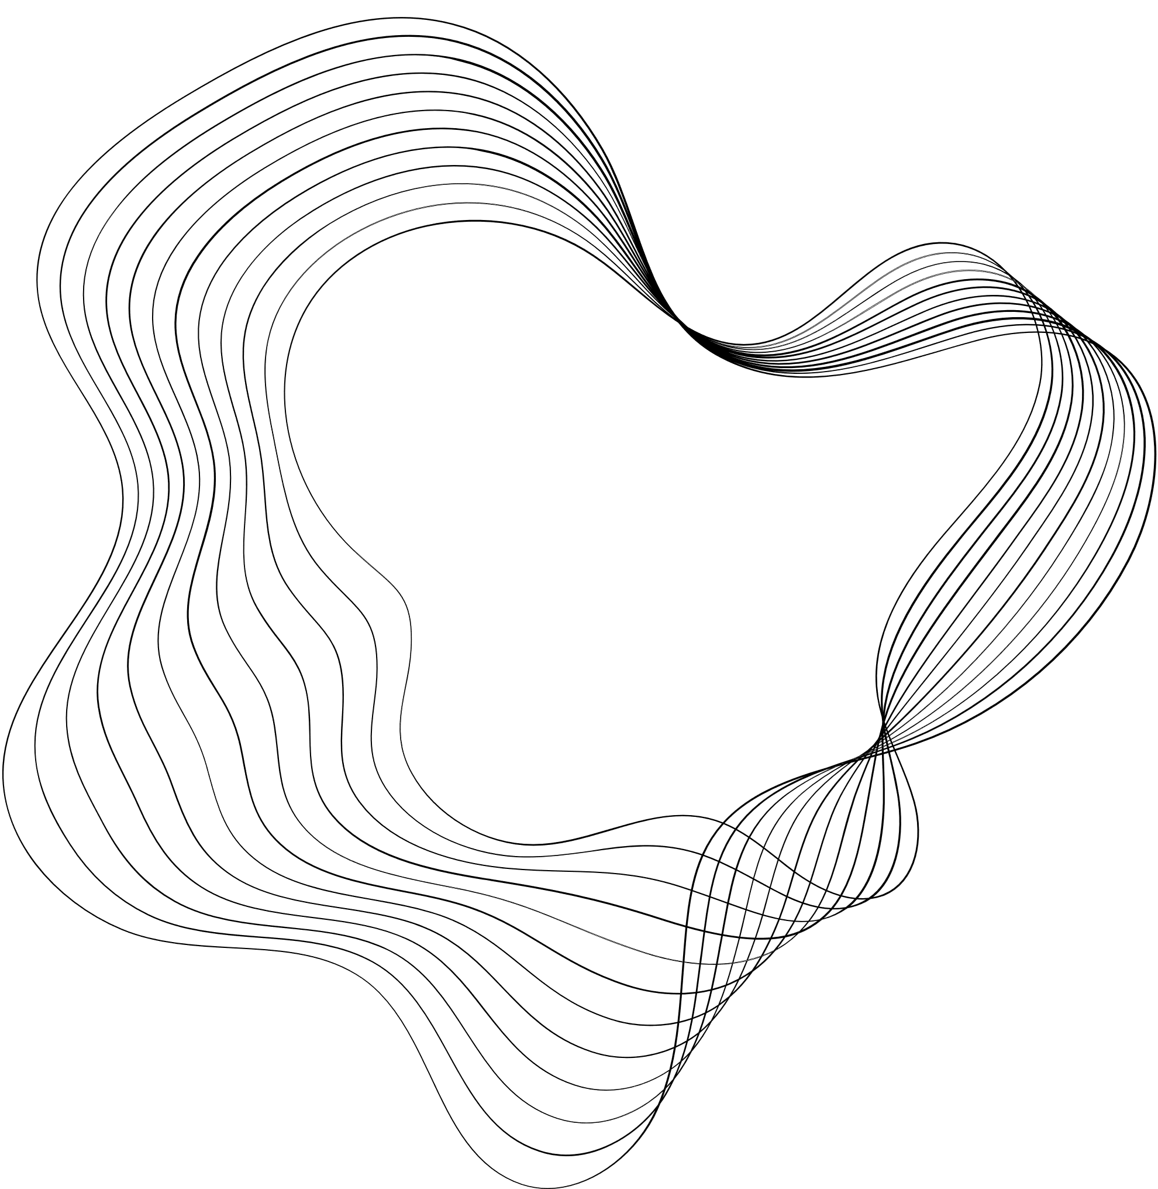
INTRODUCTION
The chosen topic is predicting the rating for books based on different parameters.
The topic of the project is actually examining which parameters of a book contribute to a higher rating, and thus it is possible to be used by readers to choose a favorite book, or used by stores in selling books that will be more loved.

Slide 3
CRAWLING STAGE
Creating a function that pulls relevant data from each page using BeautifulSoup
Checks at each parameter whether there are missing data and defines them as -NONE
Creating a loop that goes over the url and collects books
Finally puts everything into df

Slide 4
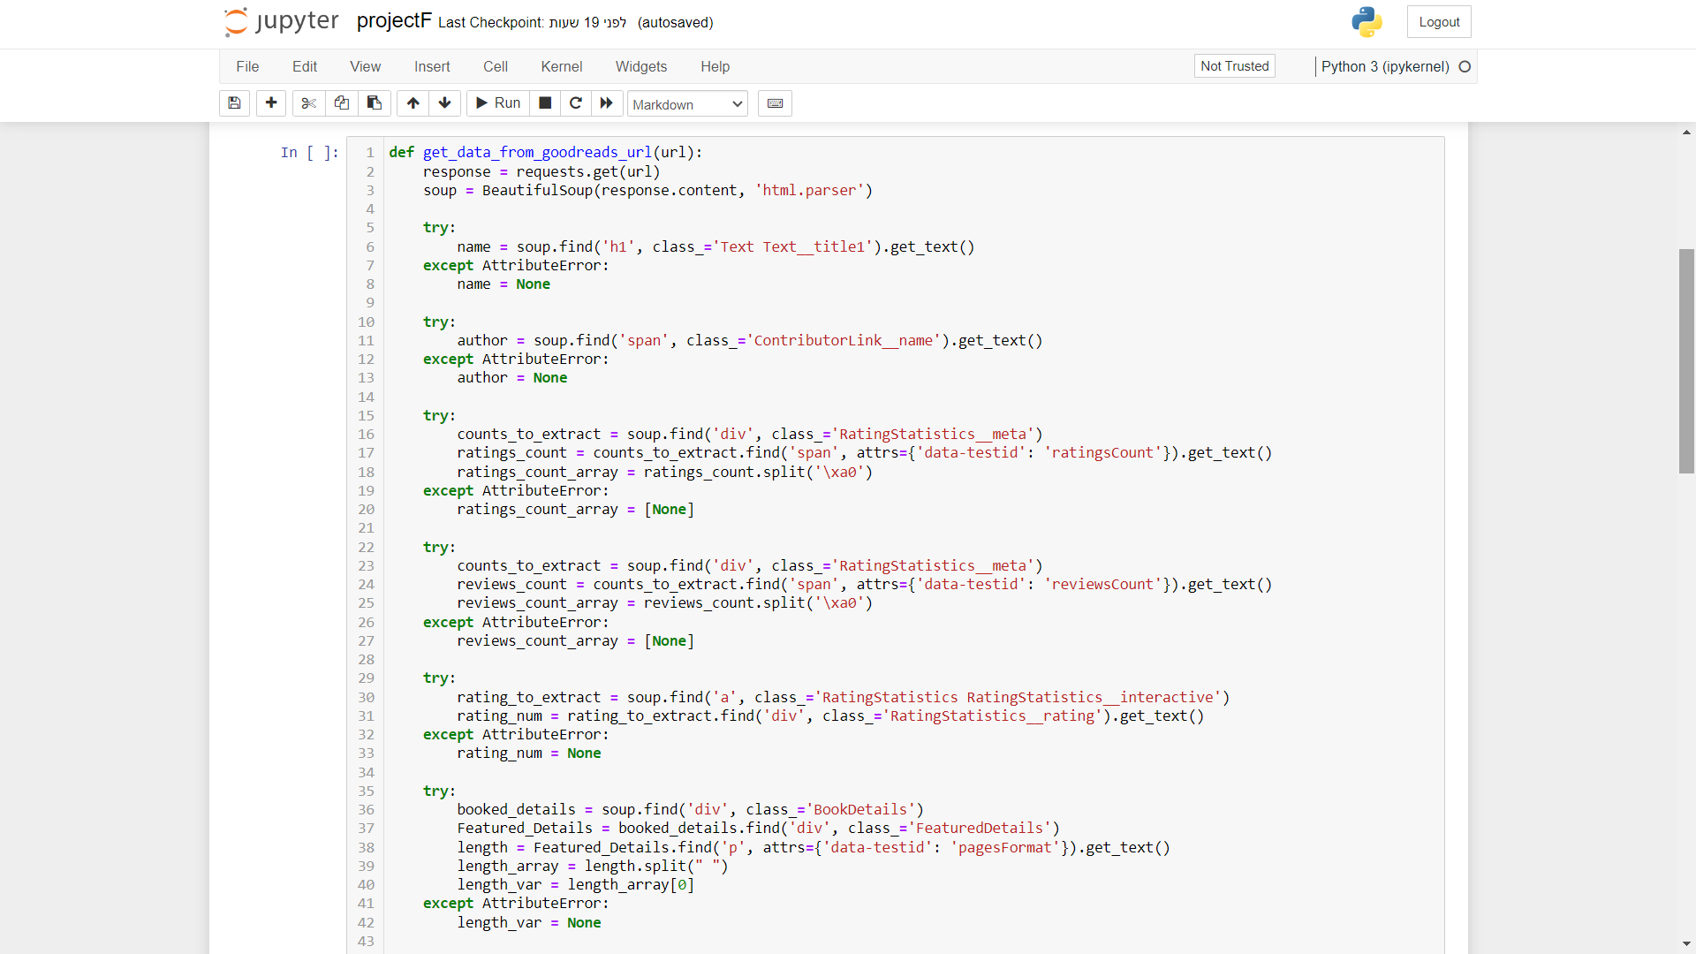
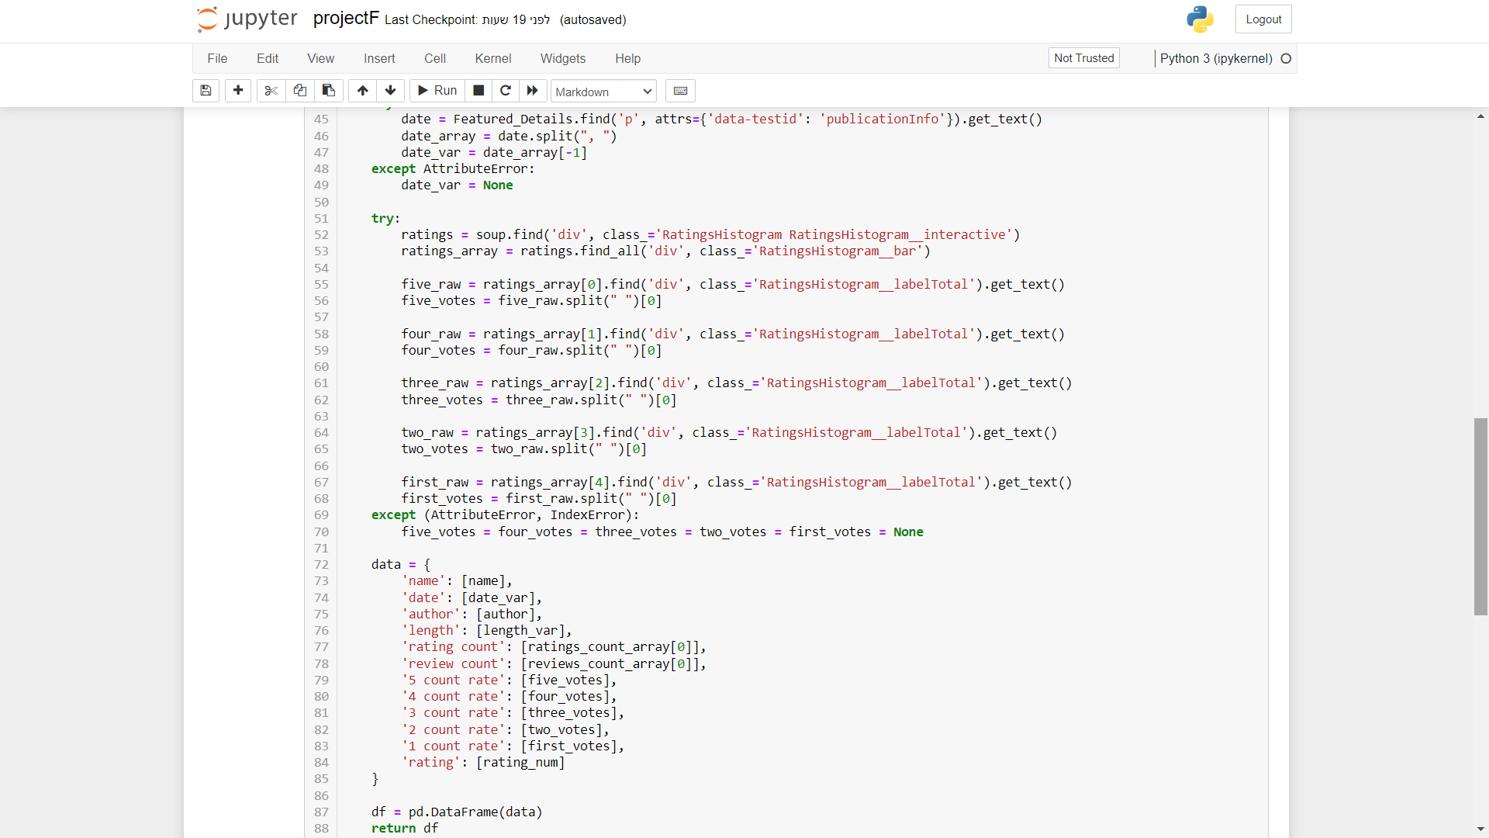

Slide 5
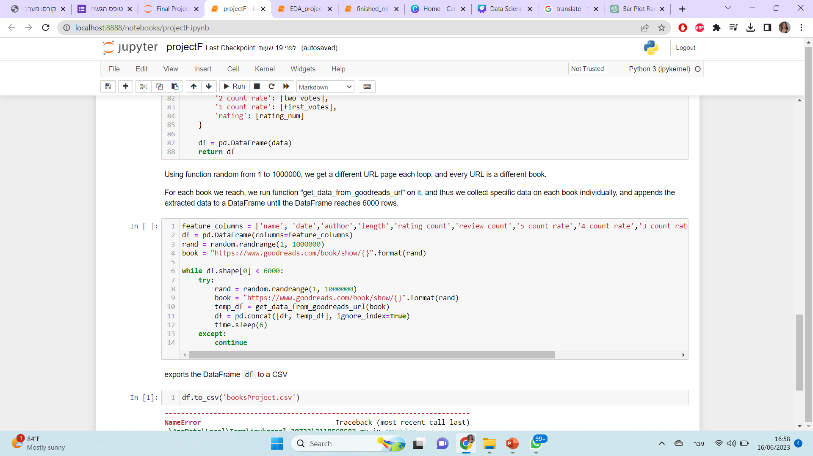

Slide 6
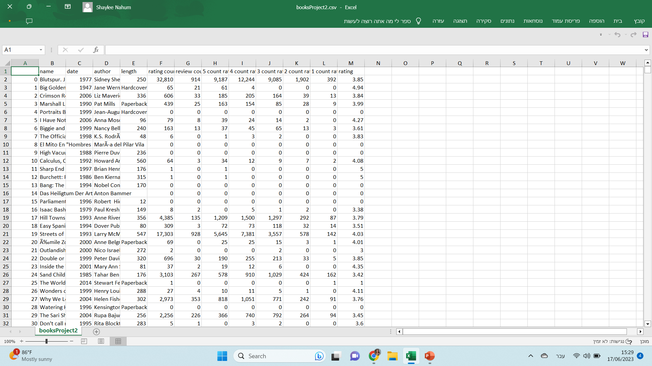

Slide 7

EDA stage
The stage where we will examine the data we have collected
Remove duplicates
Remove values ​​where there is 'NONE'
Remove irrelevant data for the prediction of the model
Displaying information about the data we have at each stage
Displaying graphs of the data and comparing them to each other

Slide 8
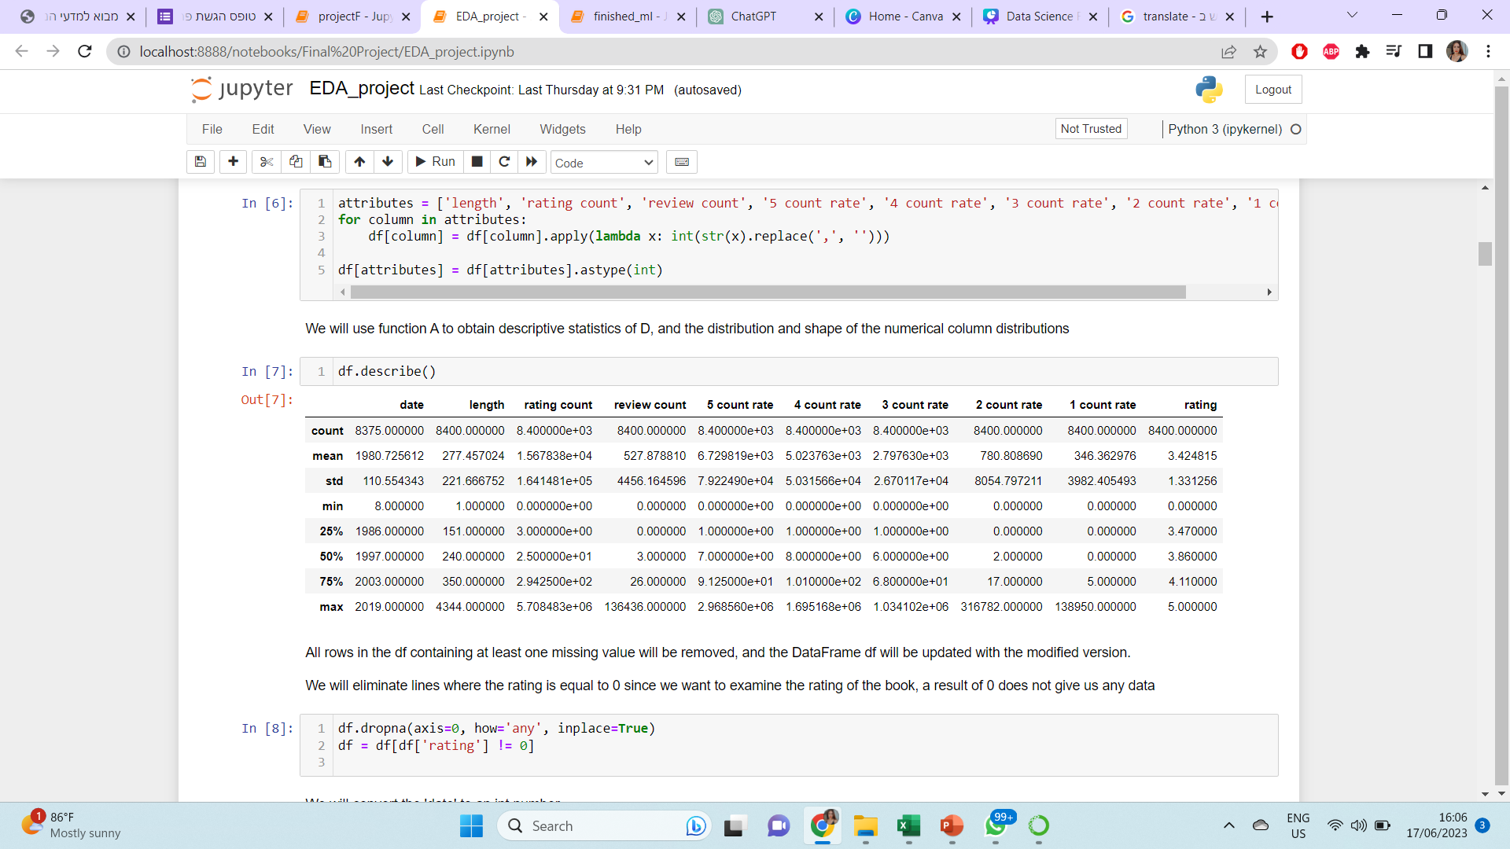
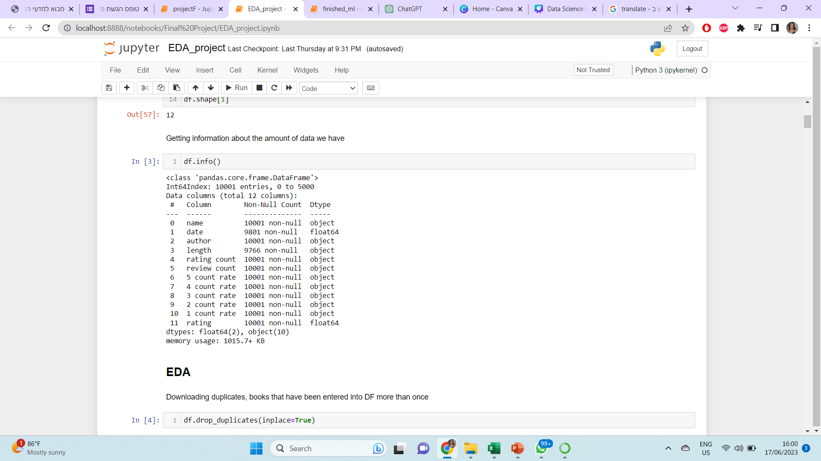

Slide 9
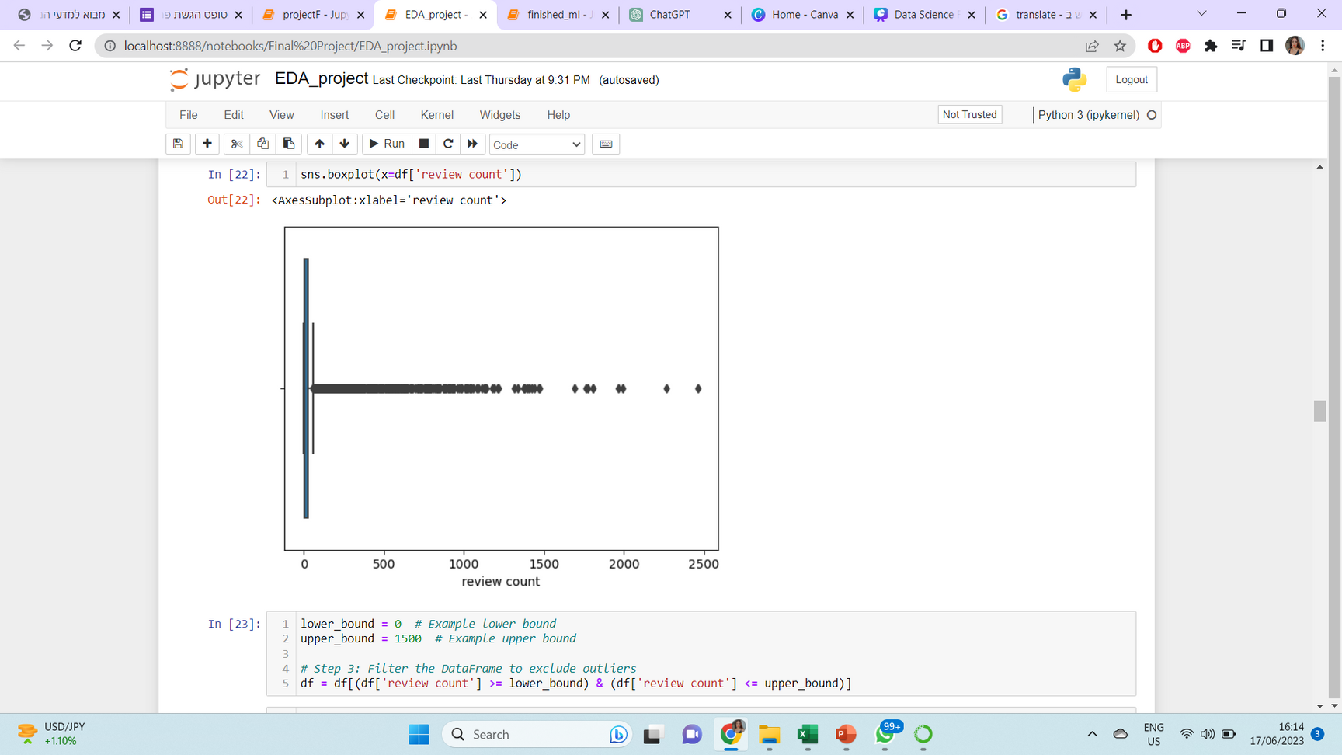
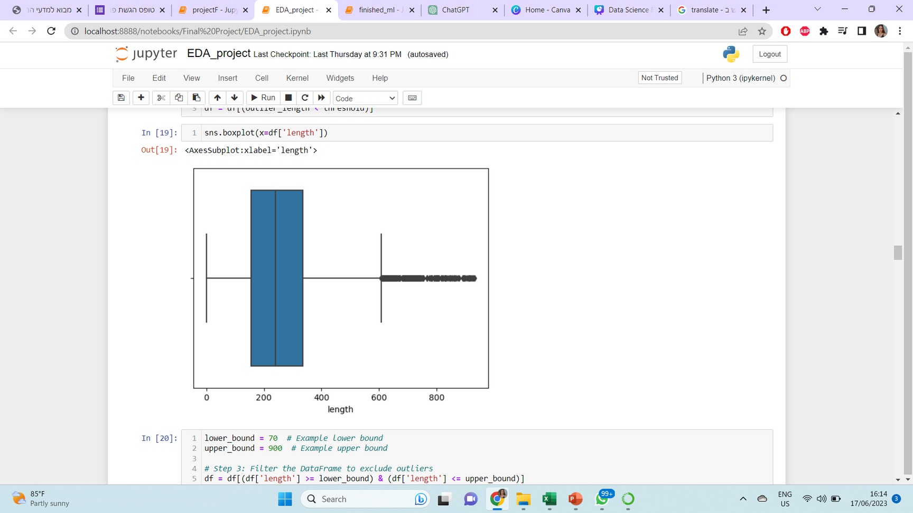
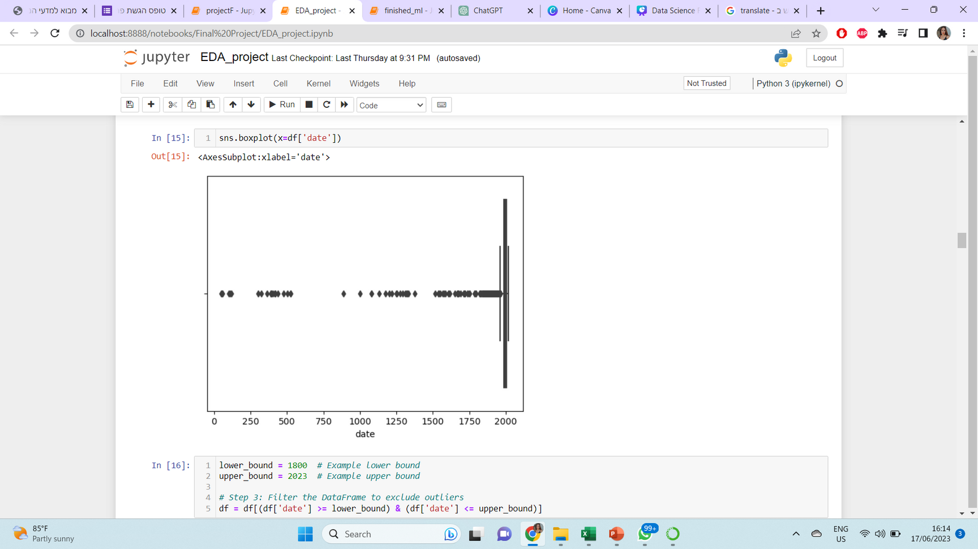
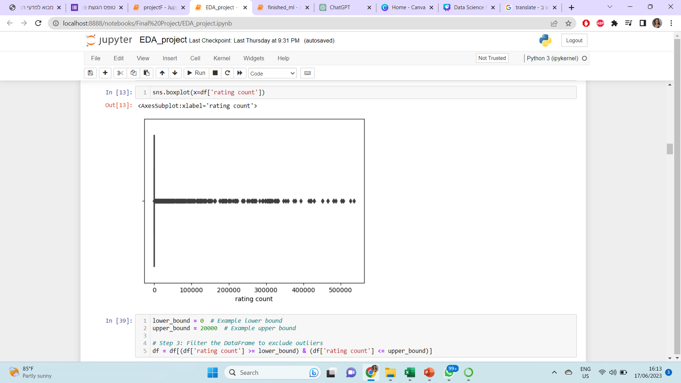
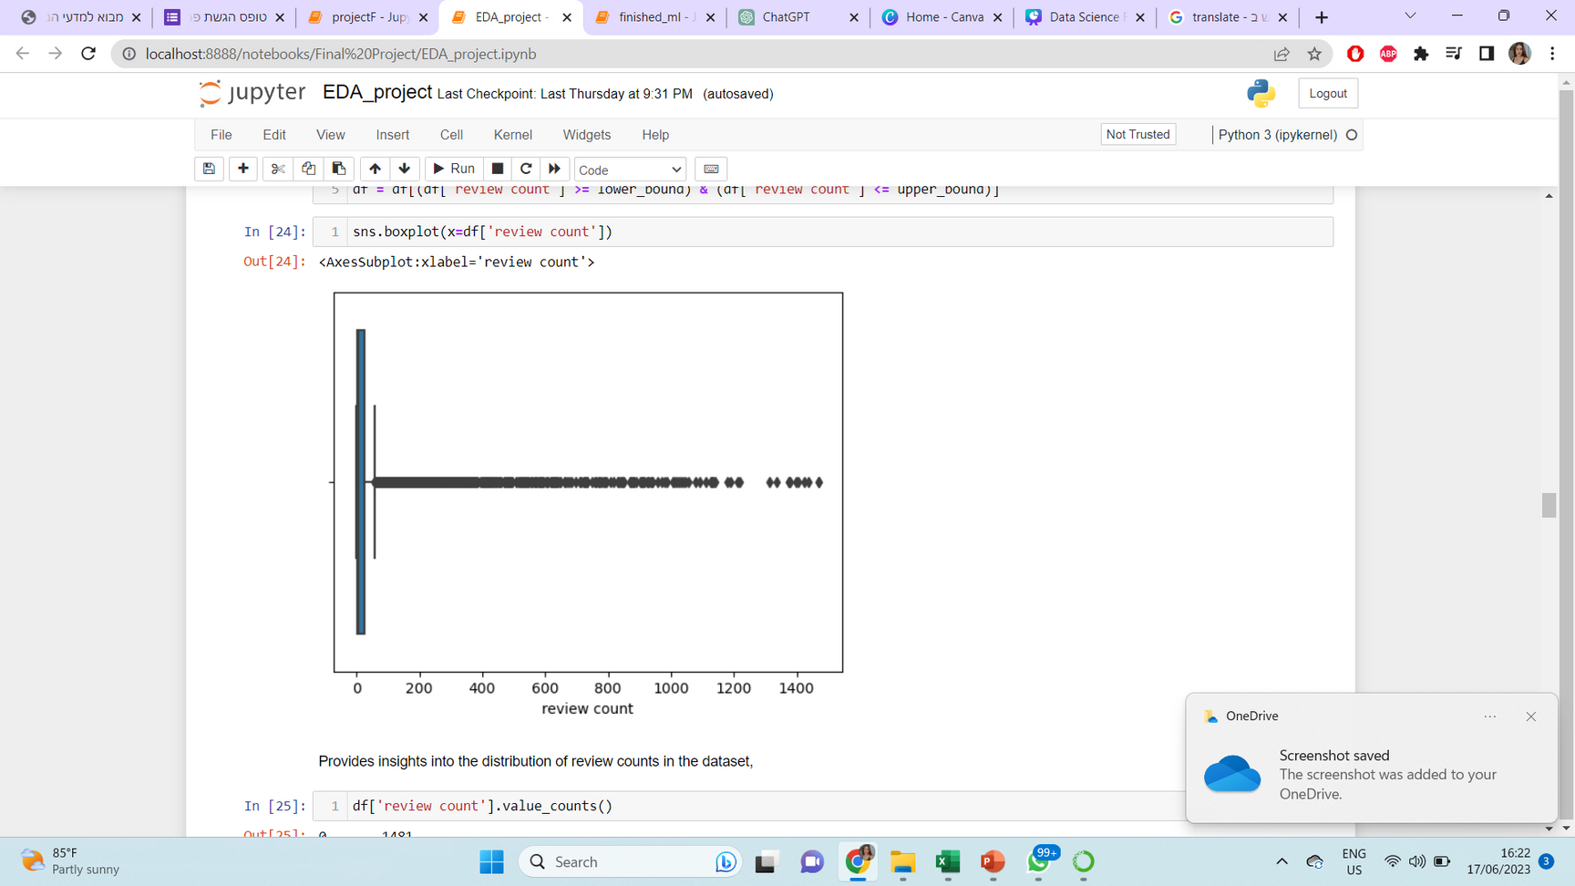
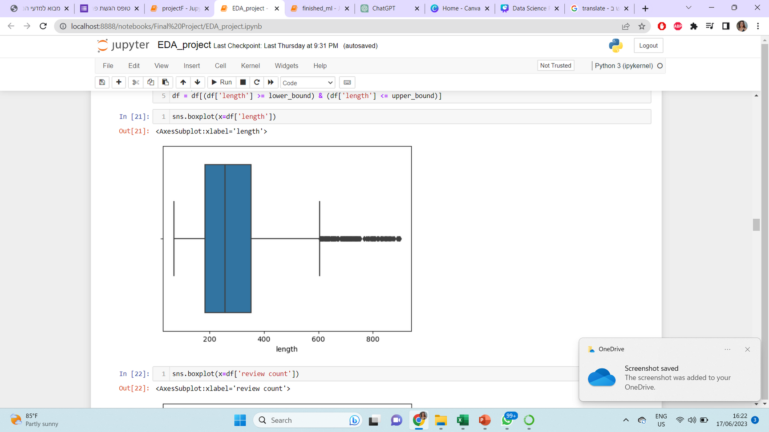
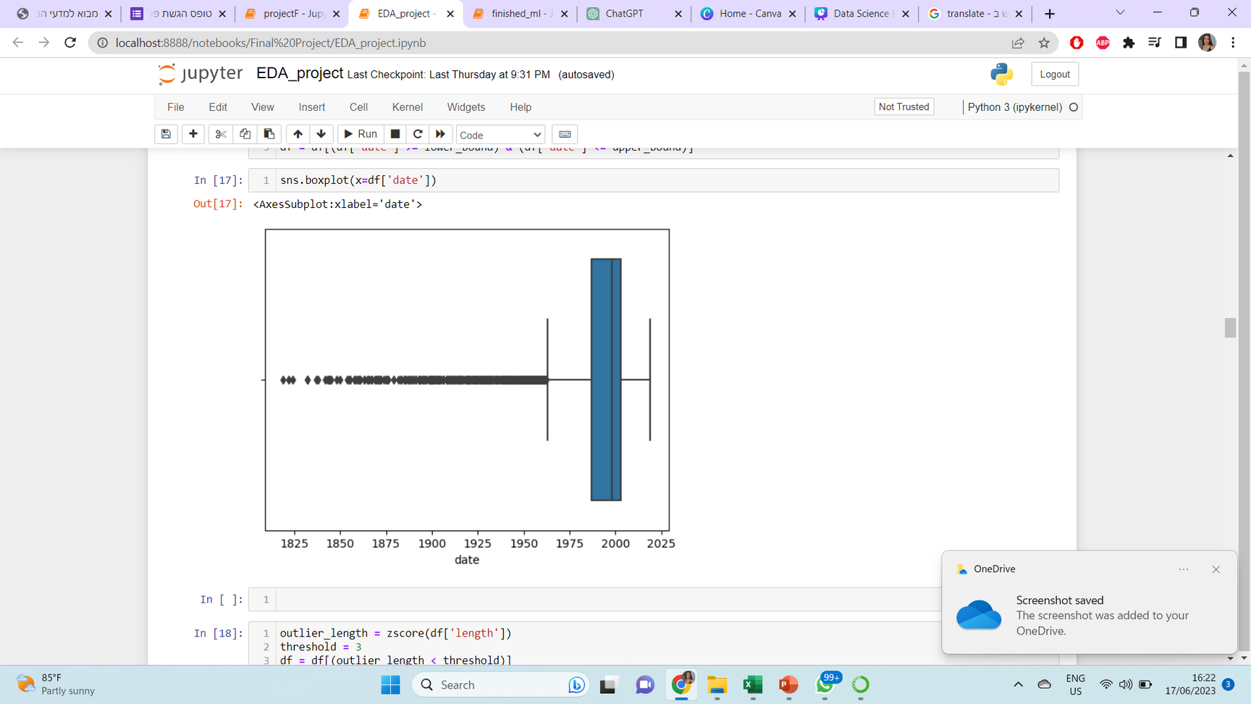
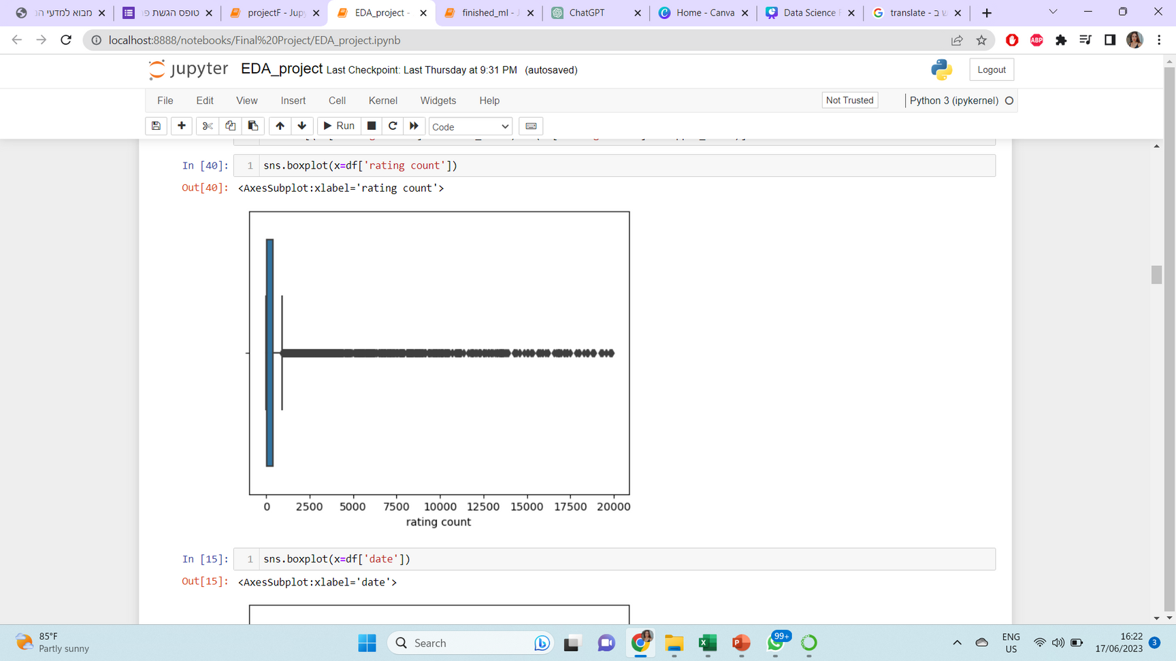
Before handling outliers
After handling outliers

Slide 10
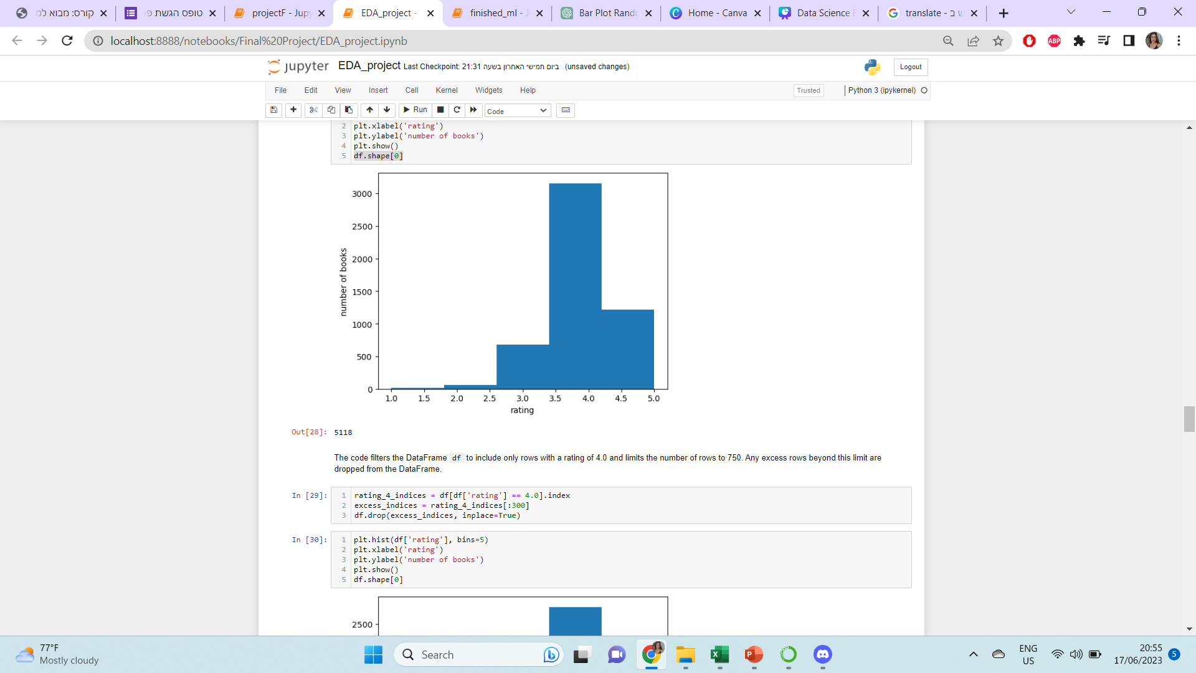
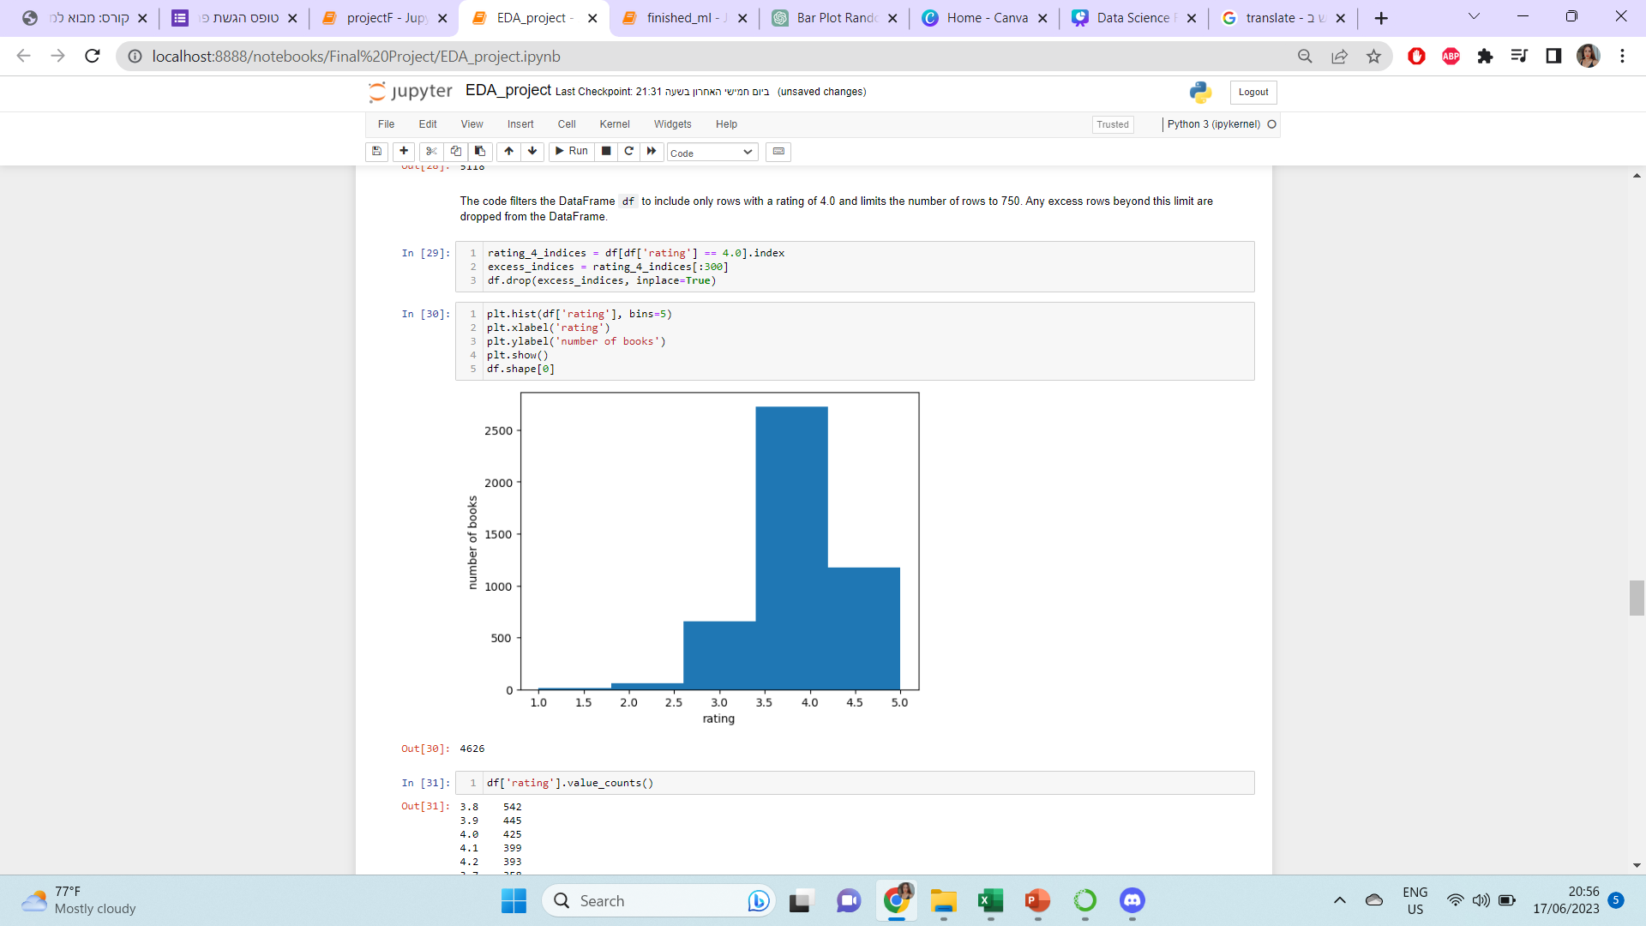

Slide 11
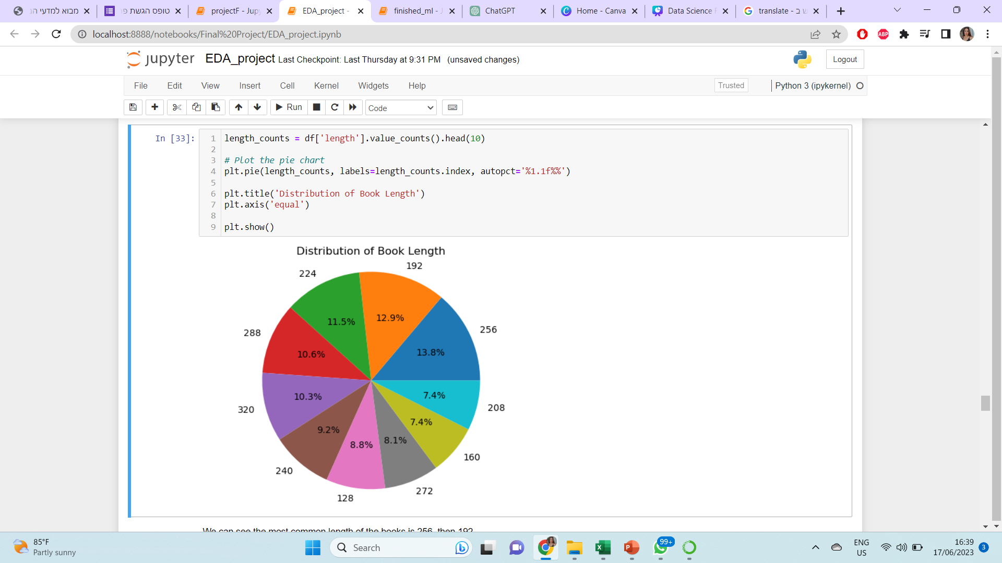

Slide 12
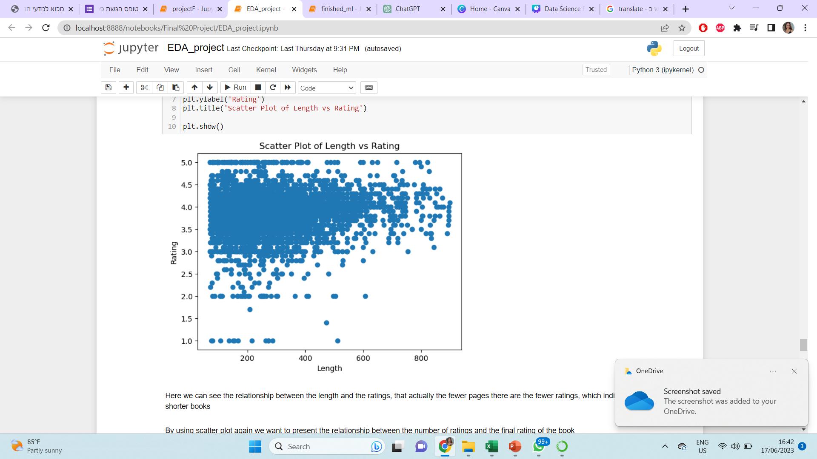
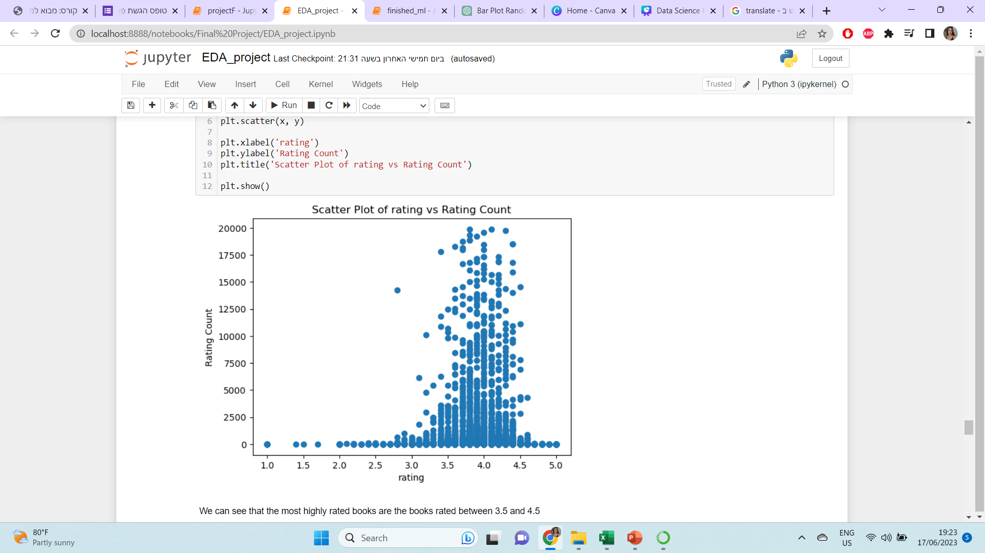
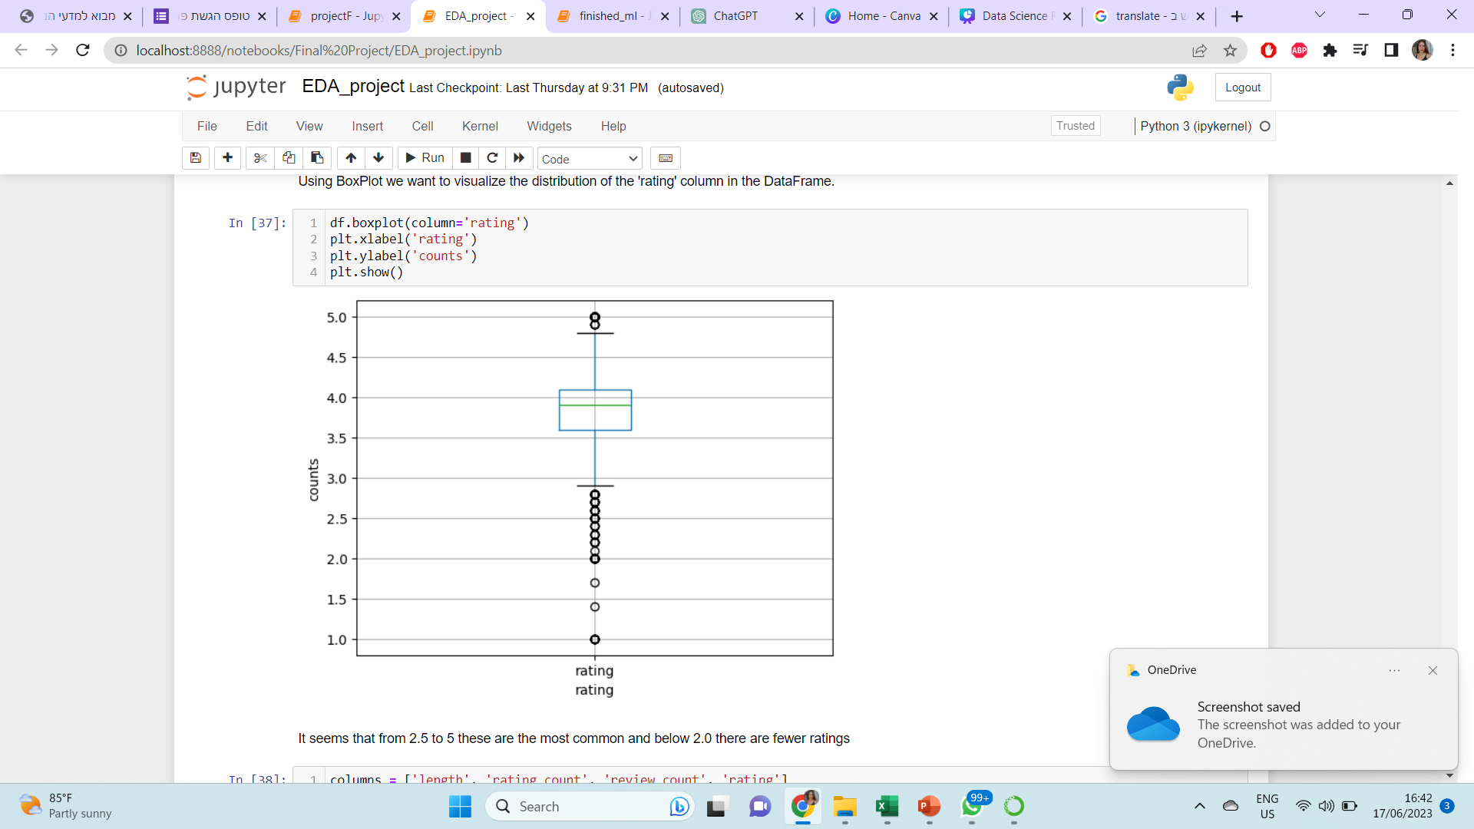
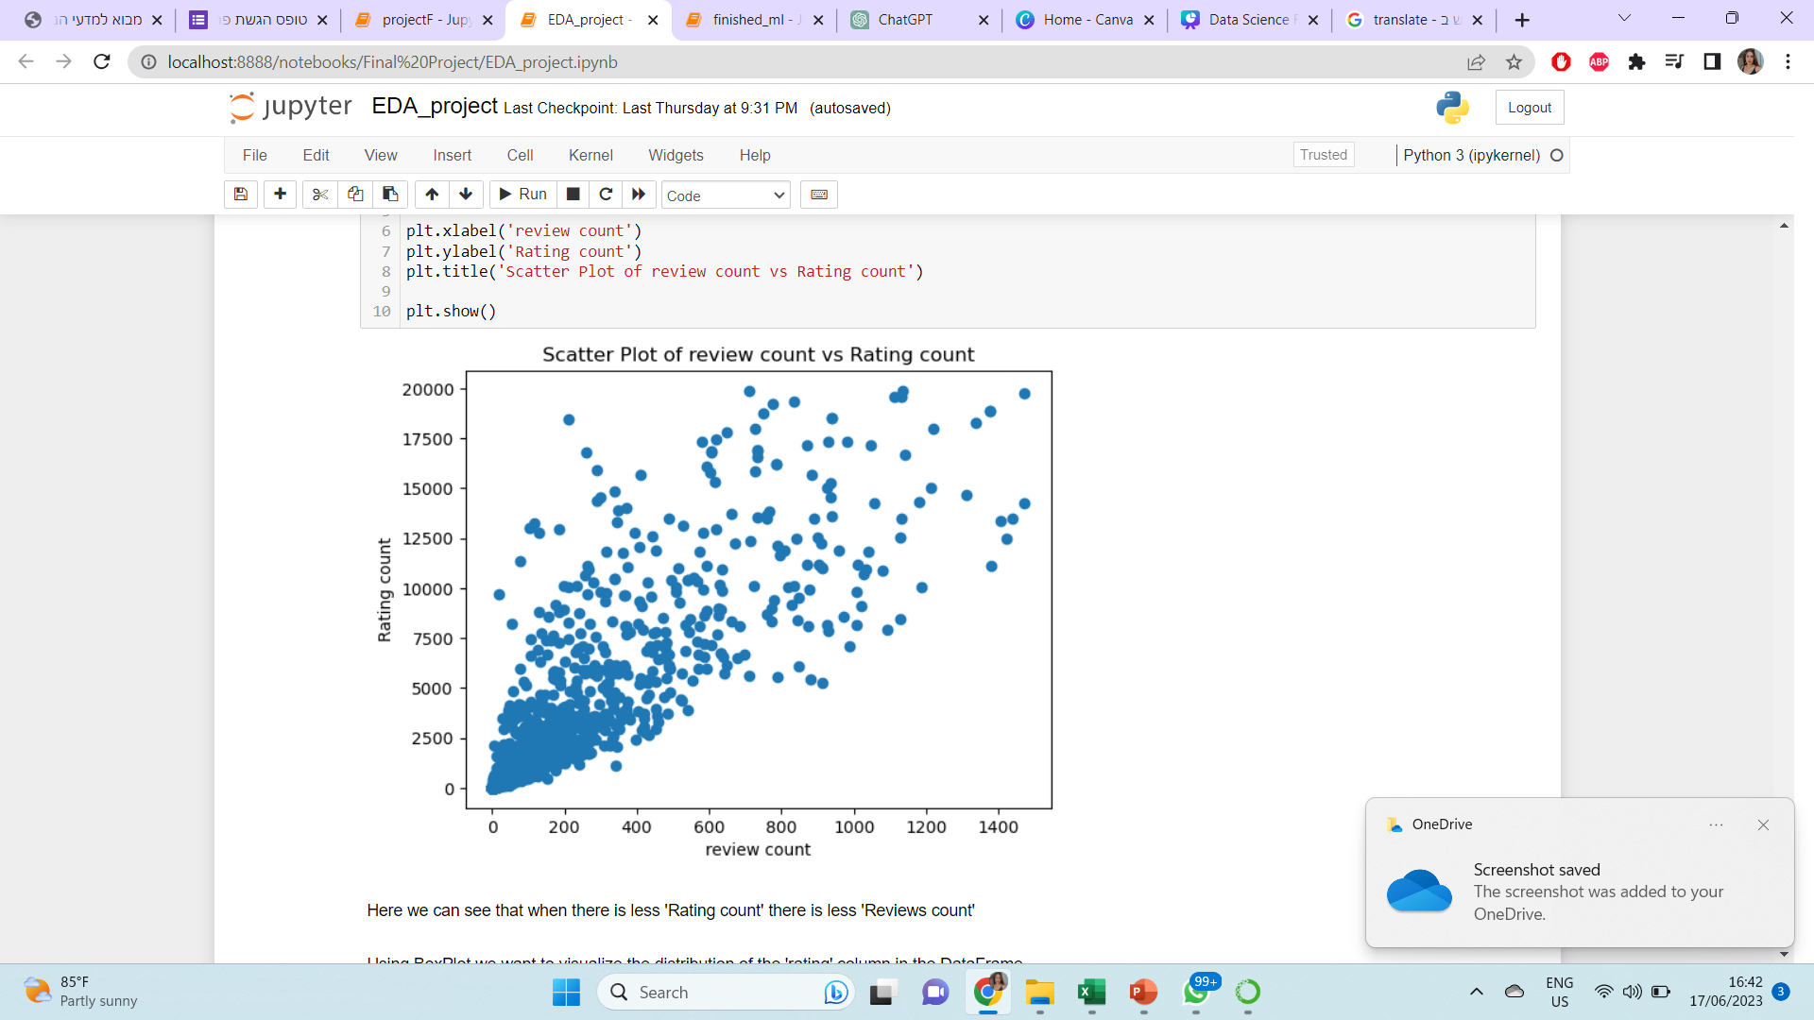

Slide 13
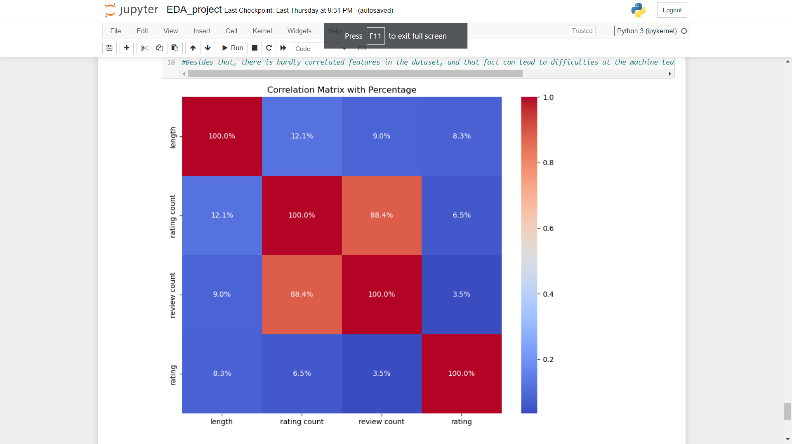

Slide 14
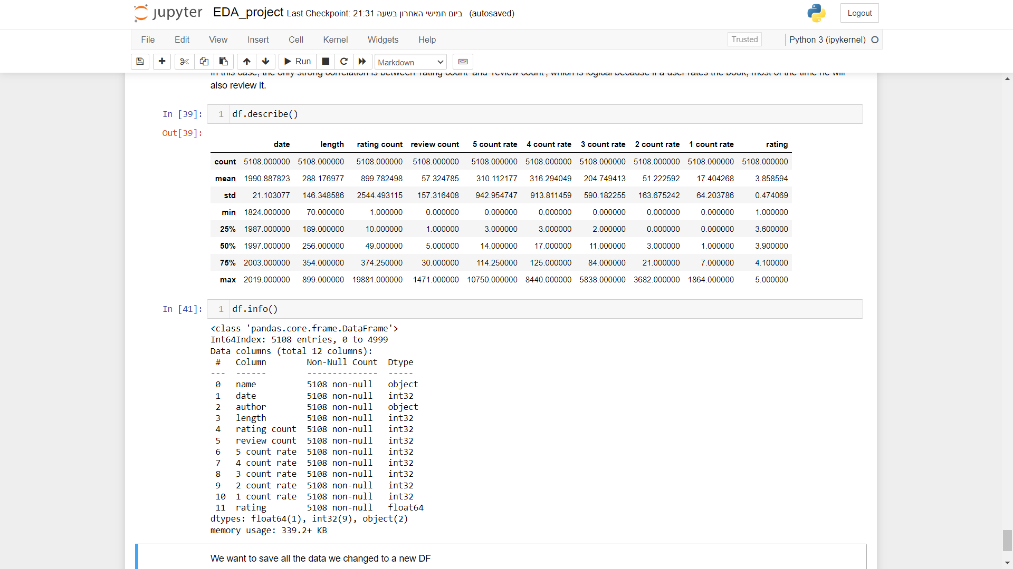

Slide 15
MACHINE LEARNING
Can we predict based on the parameters of the book what rating it will have?
Is there a connection between parameters and the rating?
To evaluate the model we will use r2 and rmse

Slide 16
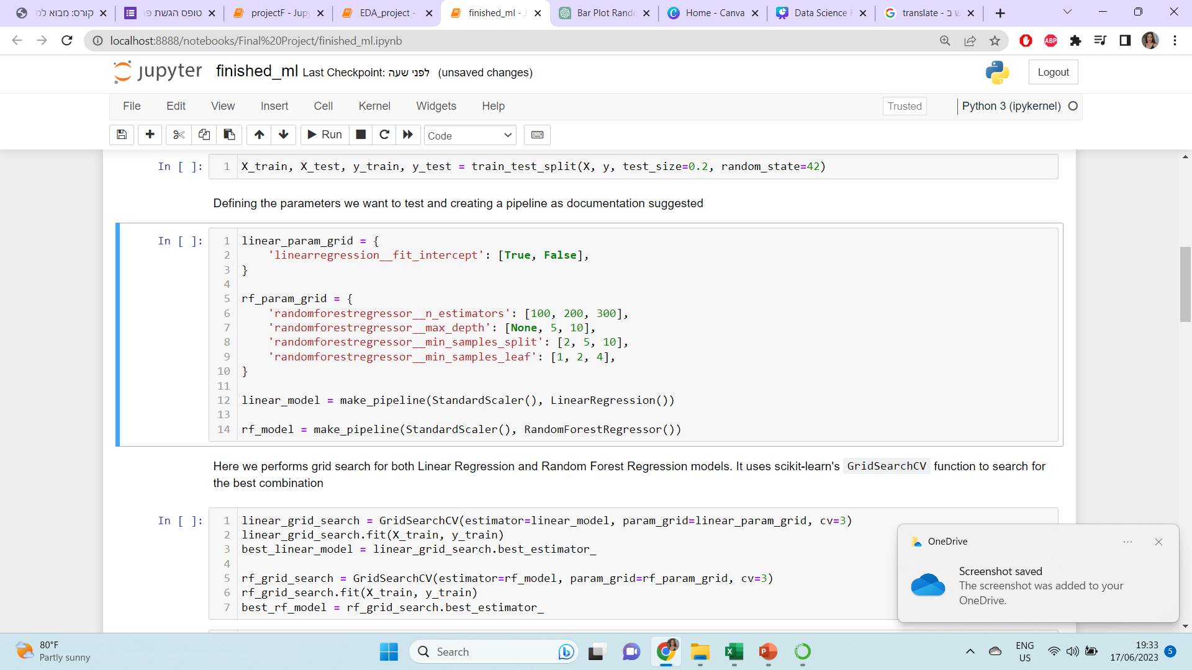
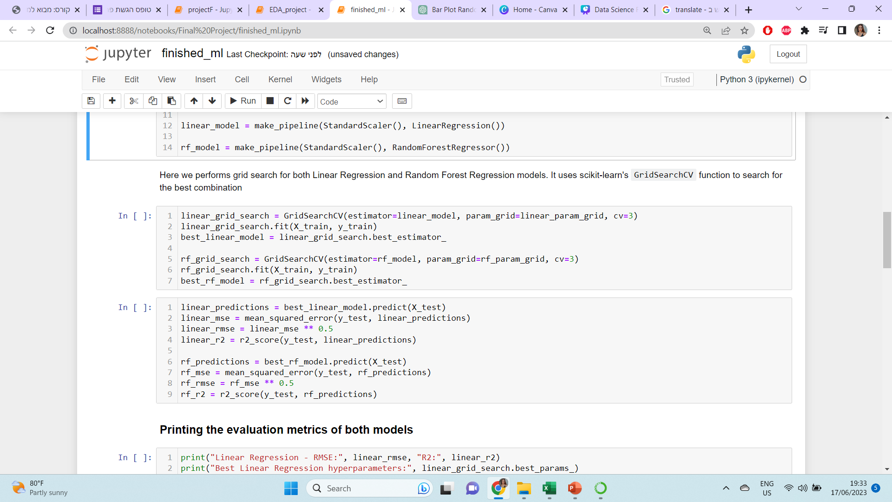

Slide 17
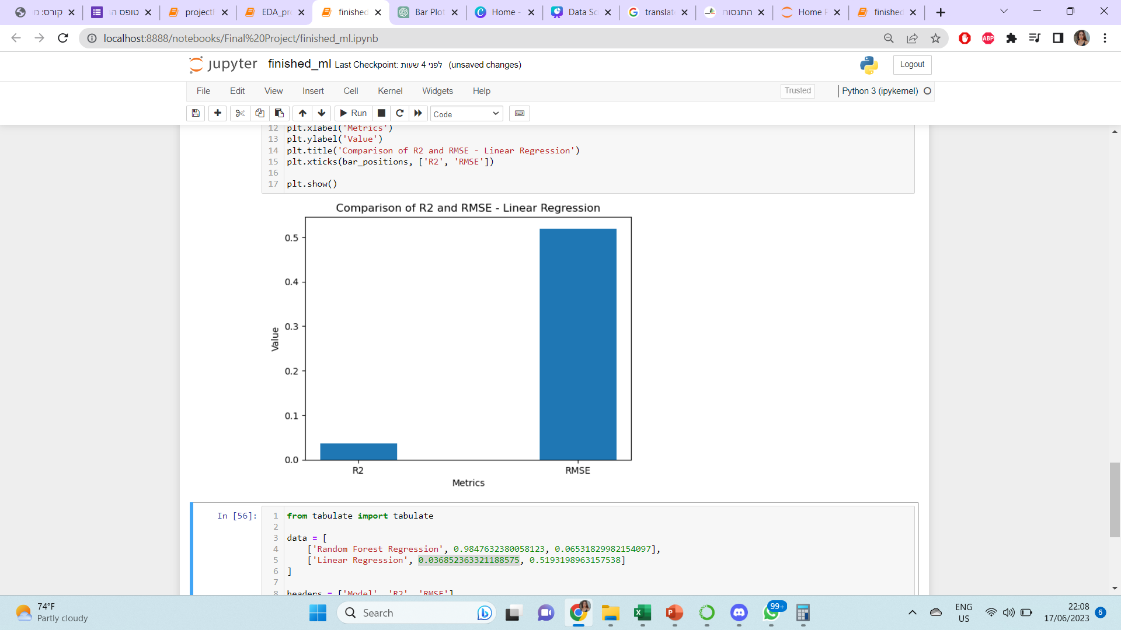
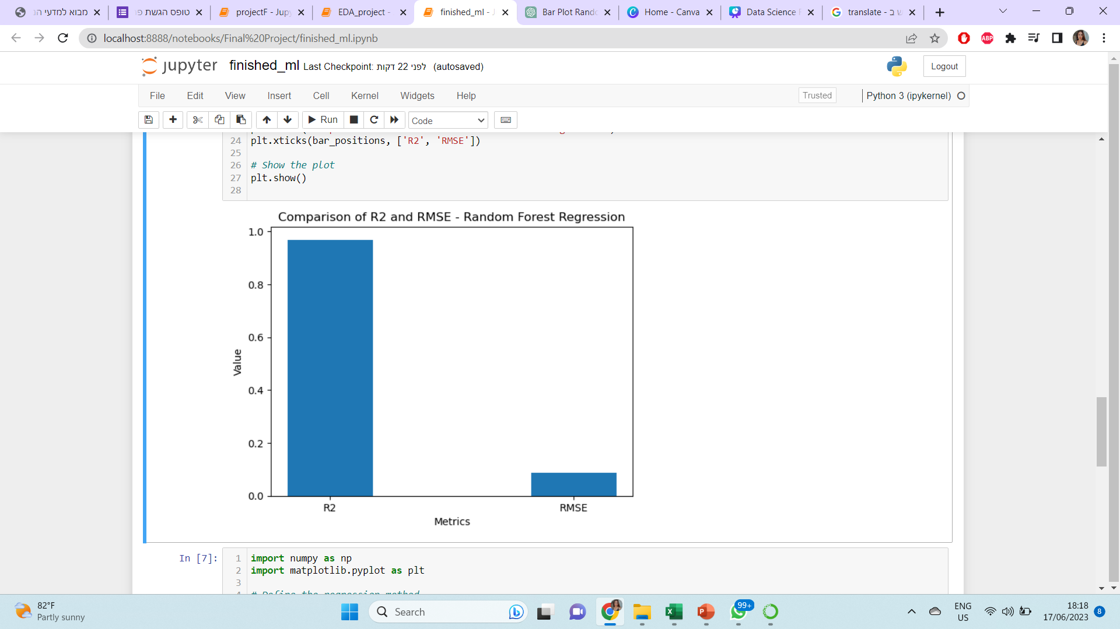
Linear Regression - RMSE: 0.5193198963157538
R2:0.036852363321188575
Random Forest Regression - RMSE: 0.06531829982154097
R2: 0.9847632380058123

Slide 18
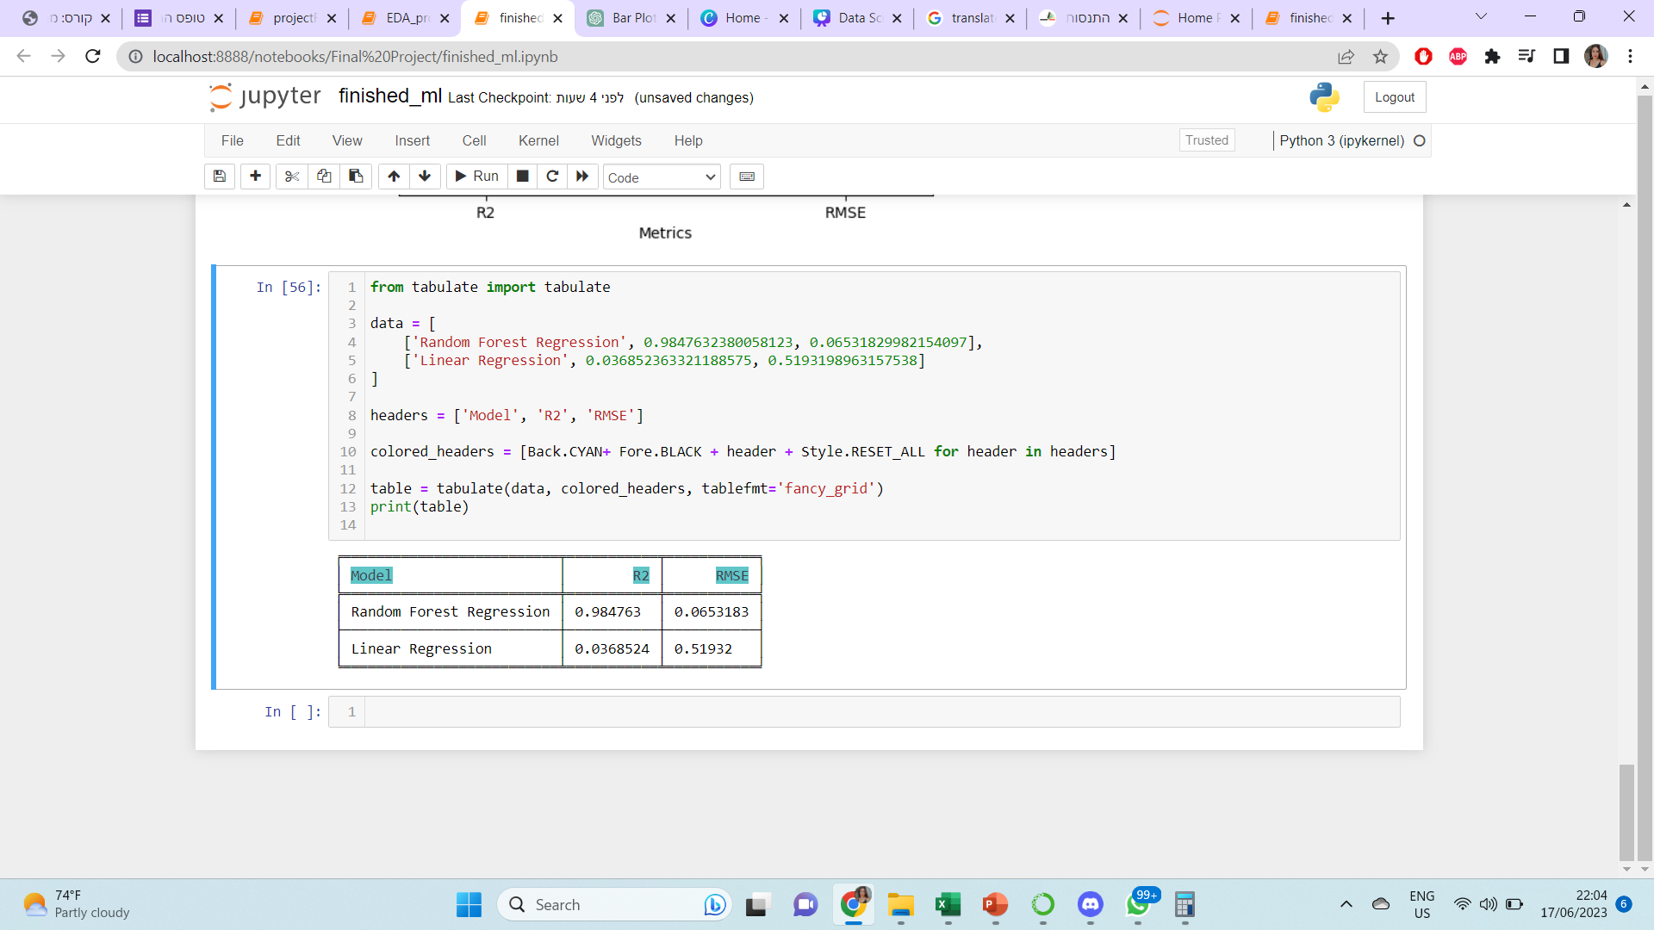
THE RESULT OF THE STUDY ACCORDING TO THE MODELS
As you can see, Linear Regression did not give us good results, the R2 value is very low, while in Random Forest we received a very high R2 value, which indicating accuracy in the data.

Slide 19
SUMMARY
In this project, we investigated the features of the books and their parameters to predict the rating. To predict this, we used linear regression, and a random forest regression. The Random Forest Regression model has the smallest RMSE and the highest R2 score. This shows that this model fits the data well. The R2 score is 0.984 and we can use this model to predict the rating.

